Slide 1
Project Management
Best Practices
Apache Traffic Control

Slide 2
Agenda
Open Source Pros & Cons
Use Case Framework
Project Management Tools & Challenges
Communication
Meetings
Github Elements
Committer vs. Non-Committer
Suggested Improvements
Blog
Roadmaps
Summary
Notes:
This presentation is part documentation, part observation, and part suggestion

Slide 3
Pros and Cons of Open Source
Pros
Lots of smart people
Backing from several large companies
Interesting challenges around scale
Cons
Communication limitations
Limited organization across resources
Distributed leadership
How you gather, manage, and use information will determine whether you win or lose.
~Bill Gates
Notes:
There are pros and cons to being open source
The limitations of open source on the organizational front are pretty significant and that’s why I want to draw attention to the project management elements of the effort because small changes here can lead to significantly higher efficiency

Slide 4
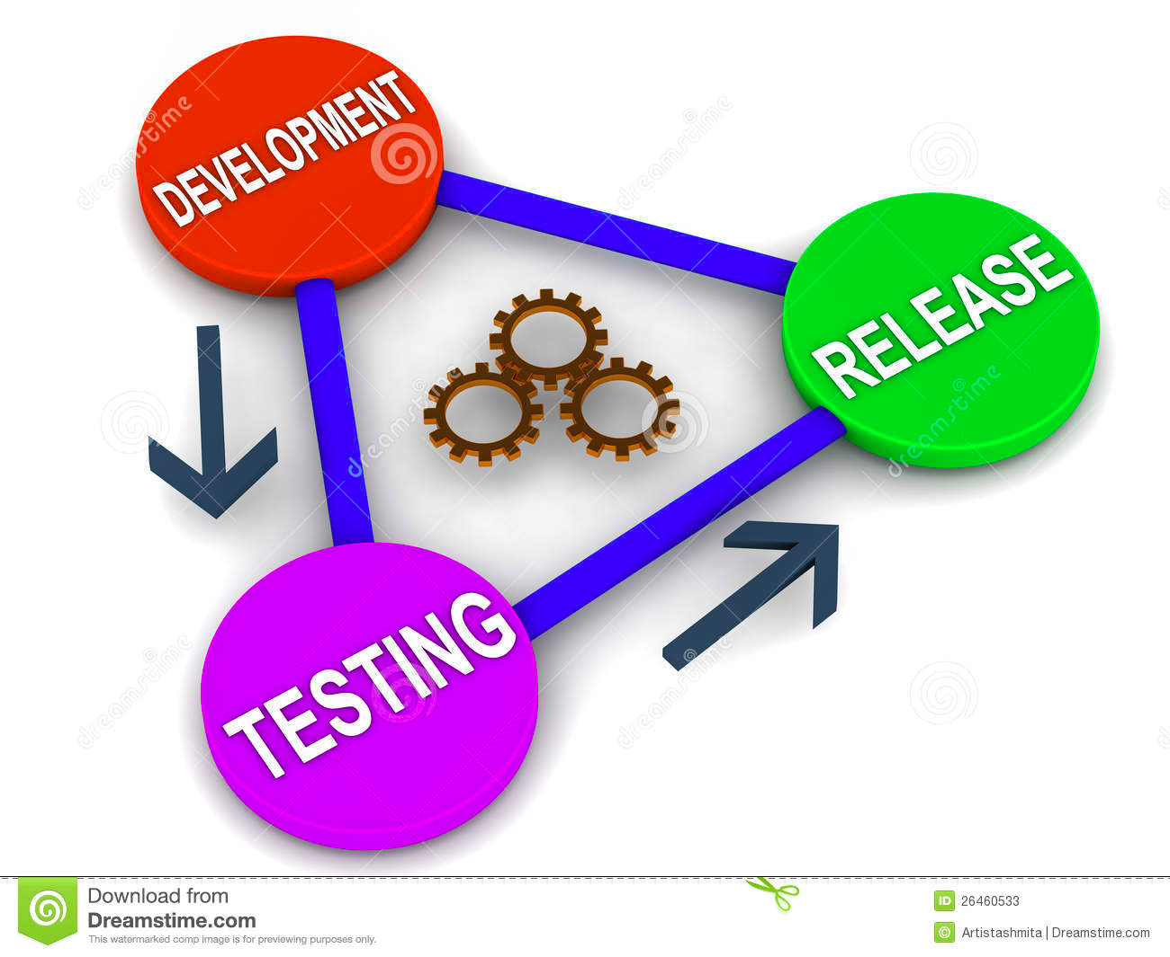
Use Case Framework
New Contributor
What is the big picture?
What is being worked?
By whom?
How can I contribute?
Release Manager
Assessing issues?
Which issues are related?
Who is working?
Tracking state?
Developer
Critical issues for components?
How will changes to other components affect mine?
How can I plan for the future?
Notes:
This is the what and why.
So lets frame what we are doing in a few use cases
We have new contributors that we want to bring up to speed
We have existing contributors participating in software releases
And we have strategic planning around interactions

Slide 5
Communication Tools
Slack
Quick questions
Immediate responses
Mailing Lists
Debate forum
Discussion of critical topics
Community updates
Wiki
Summary of mailing list outcomes
Design documentation
Notes:
Now that we have a framework of use cases we can inventory our tools and discuss pro’s and cons.
On the communications front, I actually don’t have a lot of issues.
We have good tools and they are effectively used.
I do think the confluence wiki is a little disjointed from github but that isn’t the end of the world. Maybe we move this to github eventually but not critical.

Slide 6
Meetings
Conferences
Great for face to face communication
Expensive, time consuming
Infrequent
Webex
More barriers to communication
Easier, cheaper, less time consuming
Would like to expand these if people are interested
Notes:
We have meetings as another way to ensure we stay in touch and on track.
Conferences are great but too infrequent, expensive and time consuming
We worked in a webex on configuration, which I admit didn’t start well, but I think we could potentially use this as a more regular check in on key topics where consensus is critical

Slide 7
Github - Issues & Search
Organizing Issues
Clear issue cards
Labels/keyword standards
Organize by component (project)
Create Kanban
Organize by release (milestone)
Assignees and watchers
Use @mentions to notify people and link issues
Advanced Search
no: assignee
label: bug
project: Traffic_Control
type: pr
involves: ryandurfey
is:open is:issue
Notes:
We transitioned to github from Jira recently and this is one are where we could make some significant gains.
Github has less organizational features than jira but some of them are just hiding
Issues can be improved significantly and advanced search takes a bit more knowledge

Slide 8
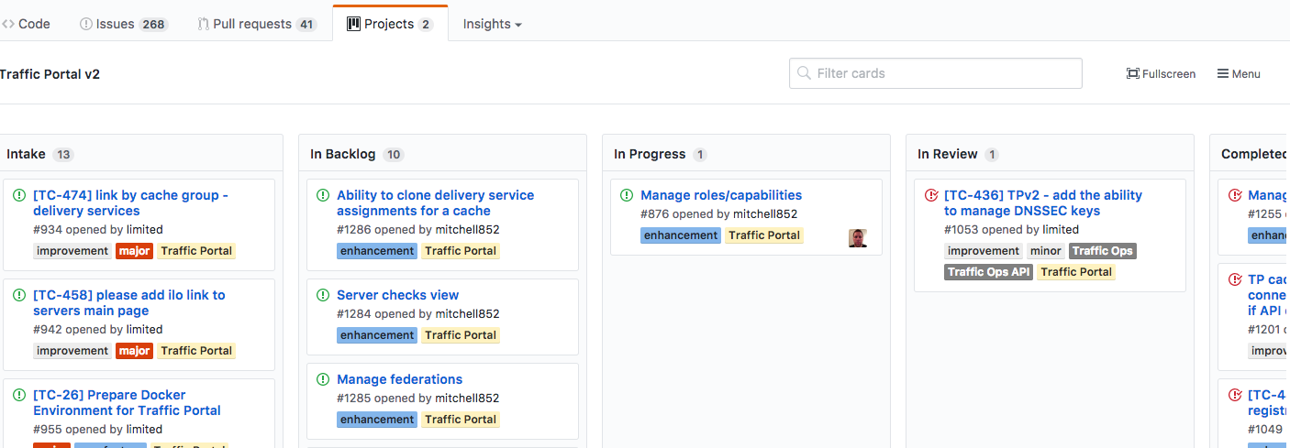
Github - Projects
Projects allow for the creation of kanban boards to organize issues
Workflow/columns can be customized
Issue can be in more than one Project
Notes:
Github Projects: are a container for related issues
In Jira we would have referred to these as components like "Traffic Router'
Projects allow for the creation of Kanban boards to organize issues
Never complete, no progress bar
Issues can belong to multiple projects
Project Boards
Support issues, pull requests, notes
Columns are customizable and used to delineate workflow state

Slide 9
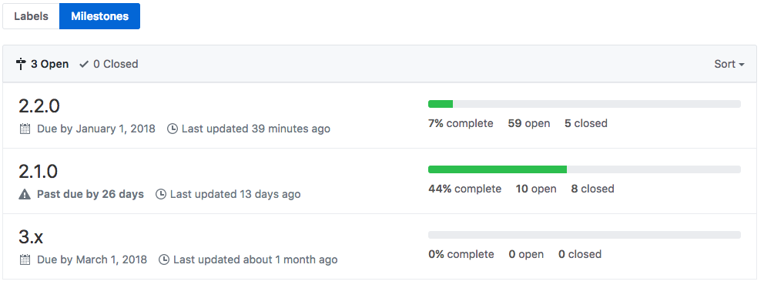
Github - Milestones
Temporary container for issues like a sprint or release
Grouped by TC version
Issues can only go in one milestone
Notes:
Milestones are container for issues like a sprint or release
These are different from projects in that issues can only belong to one milestone

Slide 10
Github - Labels
Need to properly label the issues
Ensures issues are clear and detailed
Easily searchable
Get the gist of the issue from a quick glance
Label criteria
Types: bug, feature, task (missing in Github)
Priorities: low, med, high, critical
Release affected: TC 2.0, TC 2.1, etc...
Keywords: url_signing, api_route
Duplicates: Check for existing labels before creating new
Waste: Don’t use labels for functions that already exist (ie projects / milestones)
Cache assignment
Notes:
Labels
supports multiple color coded labels - color code by type
Use for key words (api_route, crconfig, url_signing, etc...)
Use for types (bug, feature, task, etc...)
Try not to duplicate effort here

Slide 11
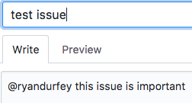
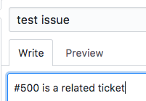
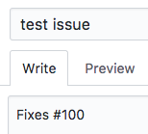
Github - Mentions
User Mention:
An @mention in a ticket notifies the user
Ticket Mention:
Commenting “#500” in a ticket, adds a reference in the referenced ticket
Keywords
“fixes” #100 would trigger the close of #100 when a commit is made
Notes:
Another underused element is the @mentions:
An @mention in a ticket makes the user a watcher adding notifications
You can create groups of users under an organization, for example "@apache/traffic_control"
Issue Mentions (by number)
When you put "#42" in a ticket it will add a reference in the referenced ticket
Close/Fix
By prefacing your commits with “Fixes”, “Fixed”, “Fix”, “Closes”, “Closed”, or “Close” when the commit is merged into master, it will also automatically close the issue.
"Fixes #42" would would trigger the close of #42 when a commit is made
Duplicates
"Duplicate of #42" add this text to issues
Click undo in timeline to remove this marker

Slide 12
Github Restrictions: Committer vs Non-Committer
Non-Committer
Create/Comment Issues
Committer
CRUD Issues
CRUD Milestones
CRUD Labels
CRUD Projects / Kanbans
Issue Assignment
Close an issue
Notes:
One critical issue we found in the transition to Github is that if you are not a committer, you have very limitted options to participate.
You can’t organize work, add labels, or assign work to yourself if you are not a committer.
Not sure where to go here, but this prevents people from effectively participating in the project.

Slide 13
Other Improvements - Blog
Timeline of Key Updates
Component roadmap changes
Critical PRs implemented
Significant project changes
Upcoming Meetings / Webexes
New Team Member Info
Benefits
New users catch up more quickly
Easier to digest than email threads
Everyone stays up to date on important changes
Notes:
Blog
We don’t do this today
Proposing we summarize critical discussions and decisions every few weeks
People can get a quick summary of ongoing issues and what is most pertinent
Creates a history of these elements in a digestible format
Help new people catch up
Help experienced people get involved in other areas

Slide 14
Other Improvements - Roadmap
Project & Component Roadmaps
Where we are today
Key issues with current systems
Where we want to head long term
Link to issues and design documents
Benefits
Contributor effectiveness
Contribution alignment
Component alignment
Notes:
The other area we really struggle in is the overall direction of the project.
It’s not that I think someone should be dictating direction, but we should all have an idea about what the key SMEs are thinking about next
This drammatically influences things like contribution effectiveness, alignemnt
and alignment across componentss

Slide 15
Summary
Use Case Framework
New User
Release Manager
Developer
How do we make these people more effective?
Key Improvements
Organizing issues into projects
Key word labels
Identify SMEs, interested parties, related issues w/ mentions
Ad hoc or regular webex meetings
Blog / Timeline of important updates
High level TC and component roadmaps
Notes:
Blog
We don’t do this today
Proposing we summarize critical discussions and decisions every few weeks
People can get a quick summary of ongoing issues and what is most pertinent
Creates a history of these elements in a digestible format
Help new people catch up
Help experienced people get involved in other areas

Slide 16
Helpful Links
Github issues:
https://cwiki.apache.org/confluence/display/TC/Project+Management+for+Issues+and+Releases
Documentation standards:
https://cwiki.apache.org/confluence/display/TC/Documentation+Standards+-+Mailing+List%2C+Issues%2C+and+Wikis
https://cwiki.apache.org/confluence/display/TC/Best+Practices+for+Open+Source+Communities
https://github.com/apache/incubator-trafficcontrol/blob/master/CONTRIBUTING.md
https://cwiki.apache.org/confluence/display/TC/Wiki+Page+Guidelines+for+Organizing+Content
Document on release management process
https://cwiki.apache.org/confluence/display/TC/Release+Management+Process

